Slide 1
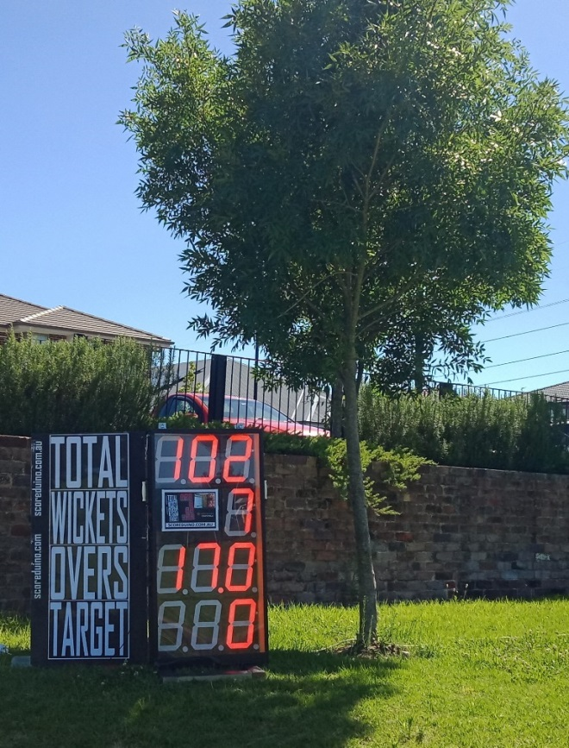
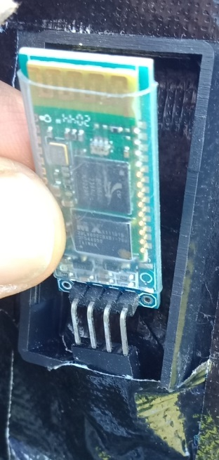
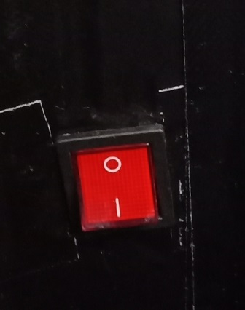
KEEP THE SCOREBOARD IN SHADE
Protect the
Bluetooth module against RAIN
Turn off the scoreboard if not used

Slide 2
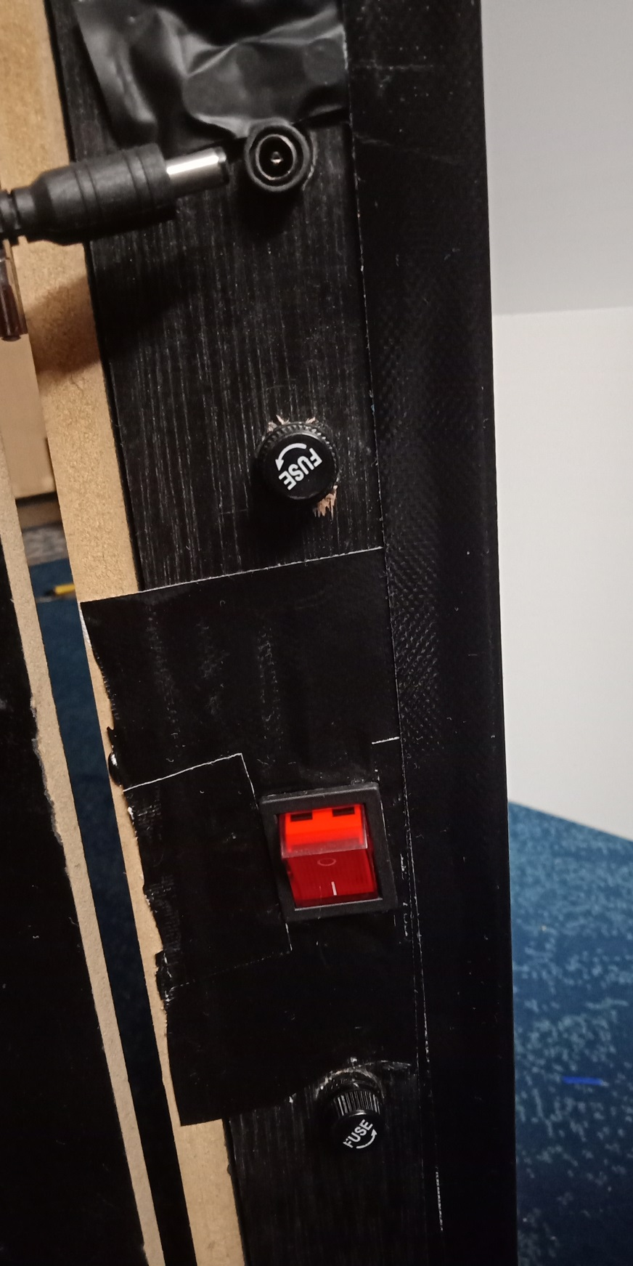
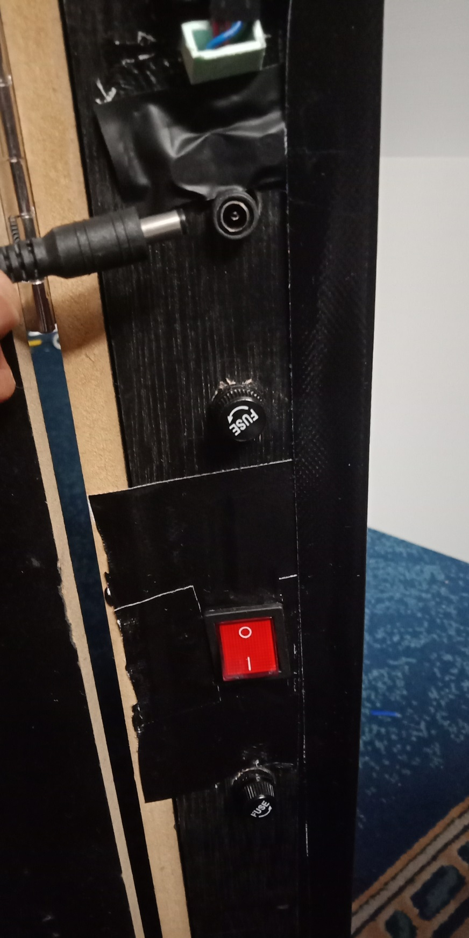
X
Turn off the switch first and plug out the power cable.
Turn off the switch first and plug in the power cable

Slide 3
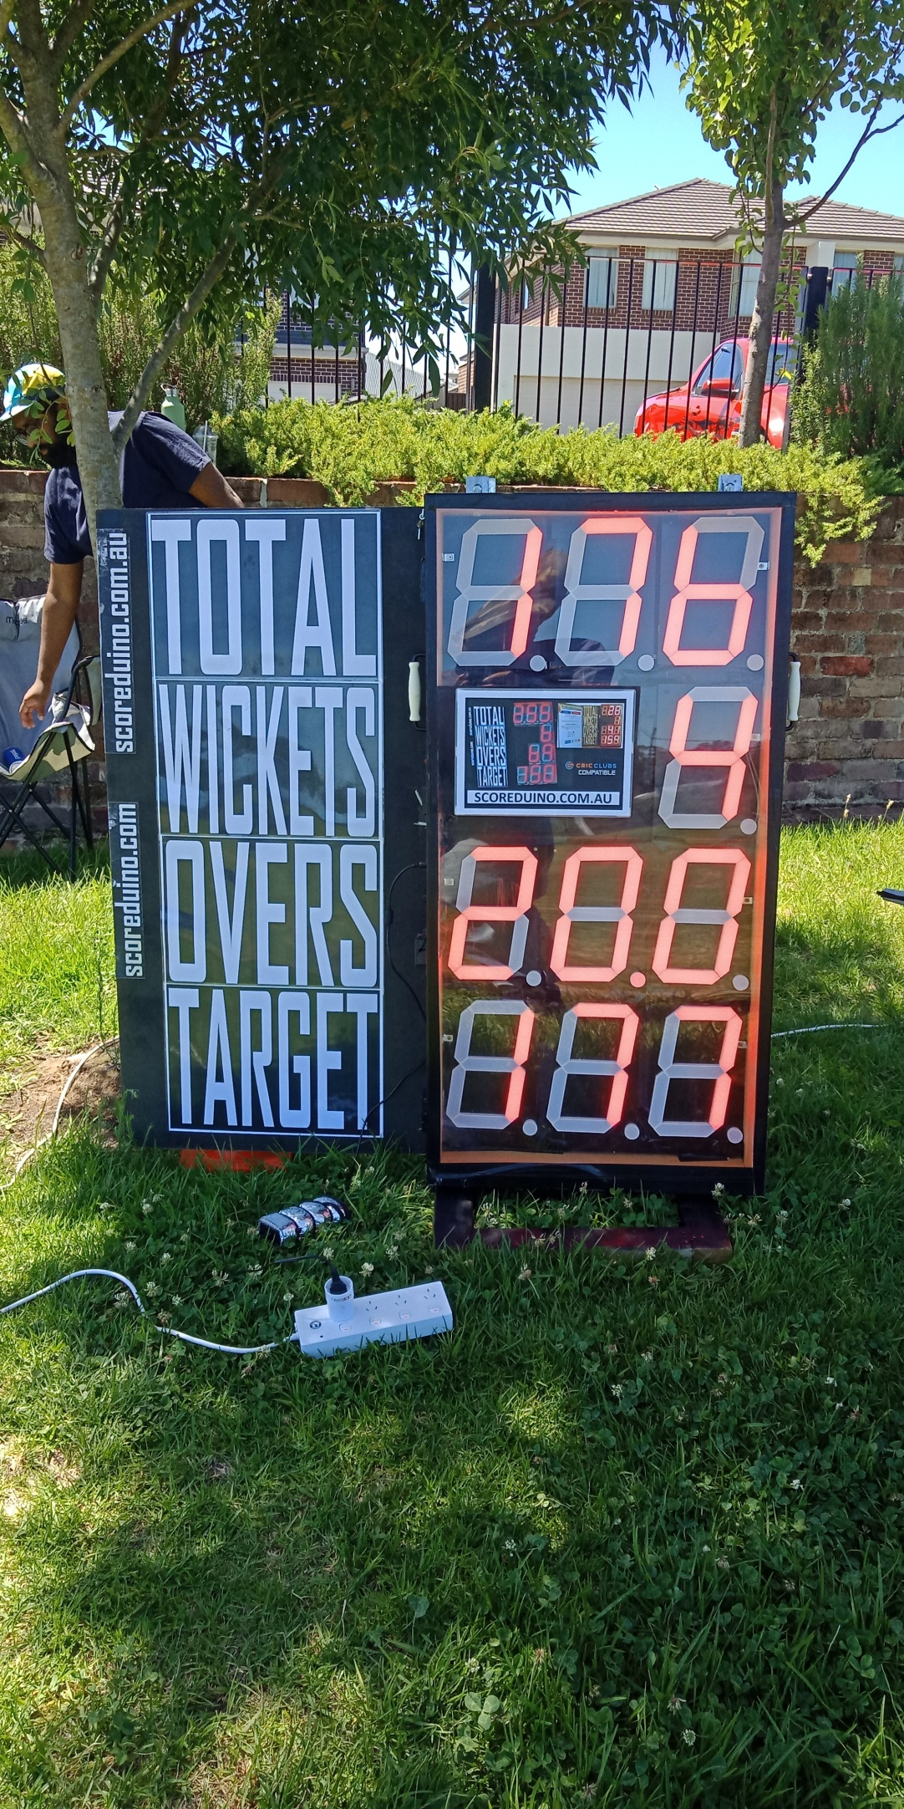
NEVER
MOVE
THE
SCOREBOARD
WHILE
IT IS
ON
Do NOT move the scoreboard while it is ON. Always turn it off first before moving. Move it how you would move your TV or Fridge.

Slide 4
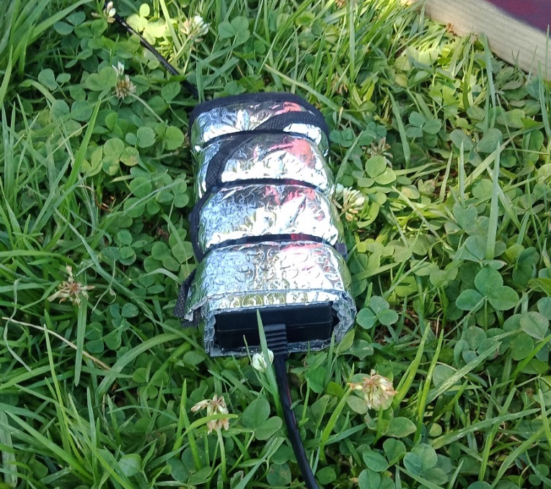


PROTECT THE POWER ADAPTER FROM
DIRECT SUNLIGHT

Slide 5
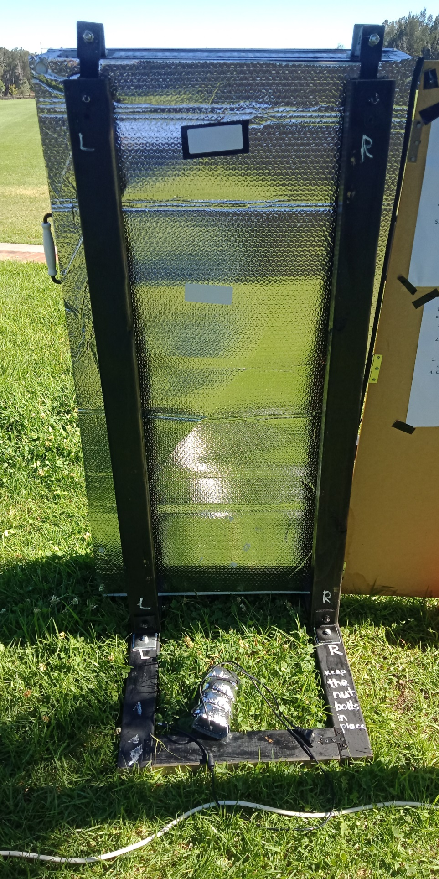
FIX THE
SCOREBOARD
IT SHOULD NOT
WIGGLE

